Slide 1
What’s it like to major in Computer Science?
Marissa Le Coz
Essex High School
Dec. 18, 2015

Slide 2
Introduction: How I ended up Majoring in Computer Science

Slide 3
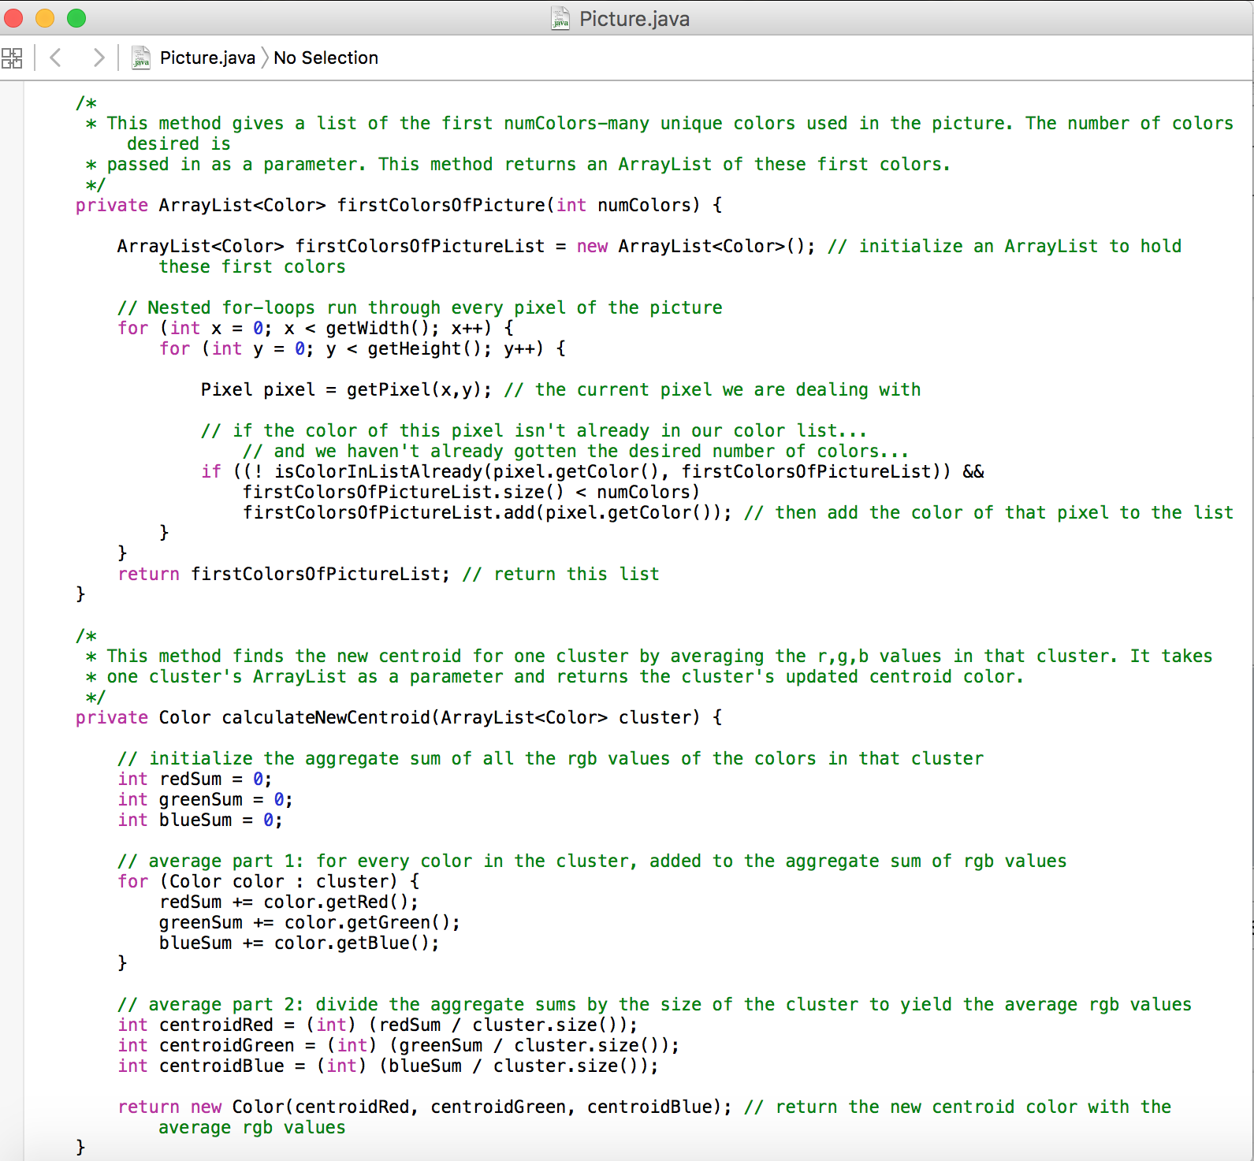

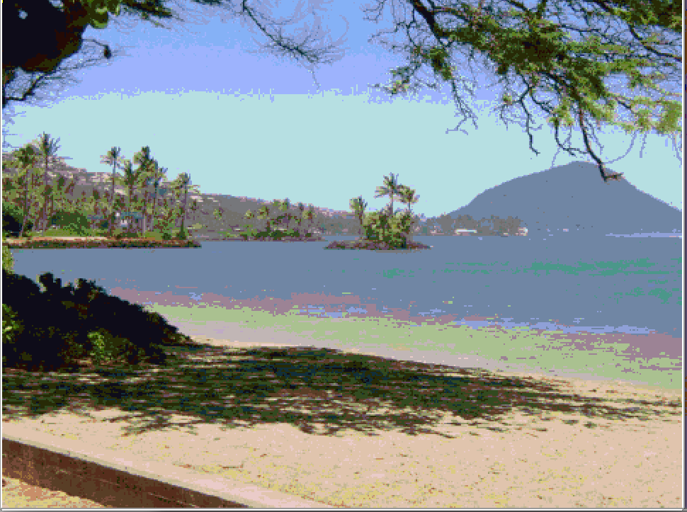
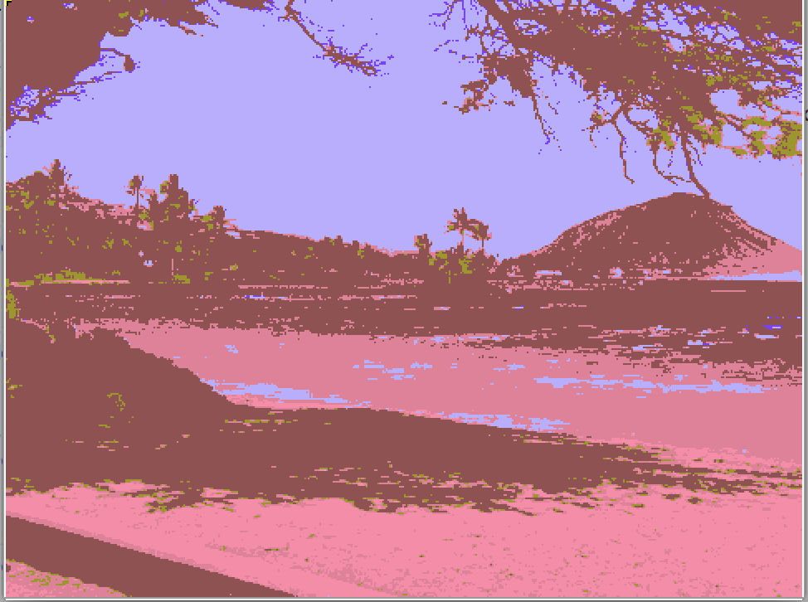
Example of cool stuff you can do with Computer science

Slide 4
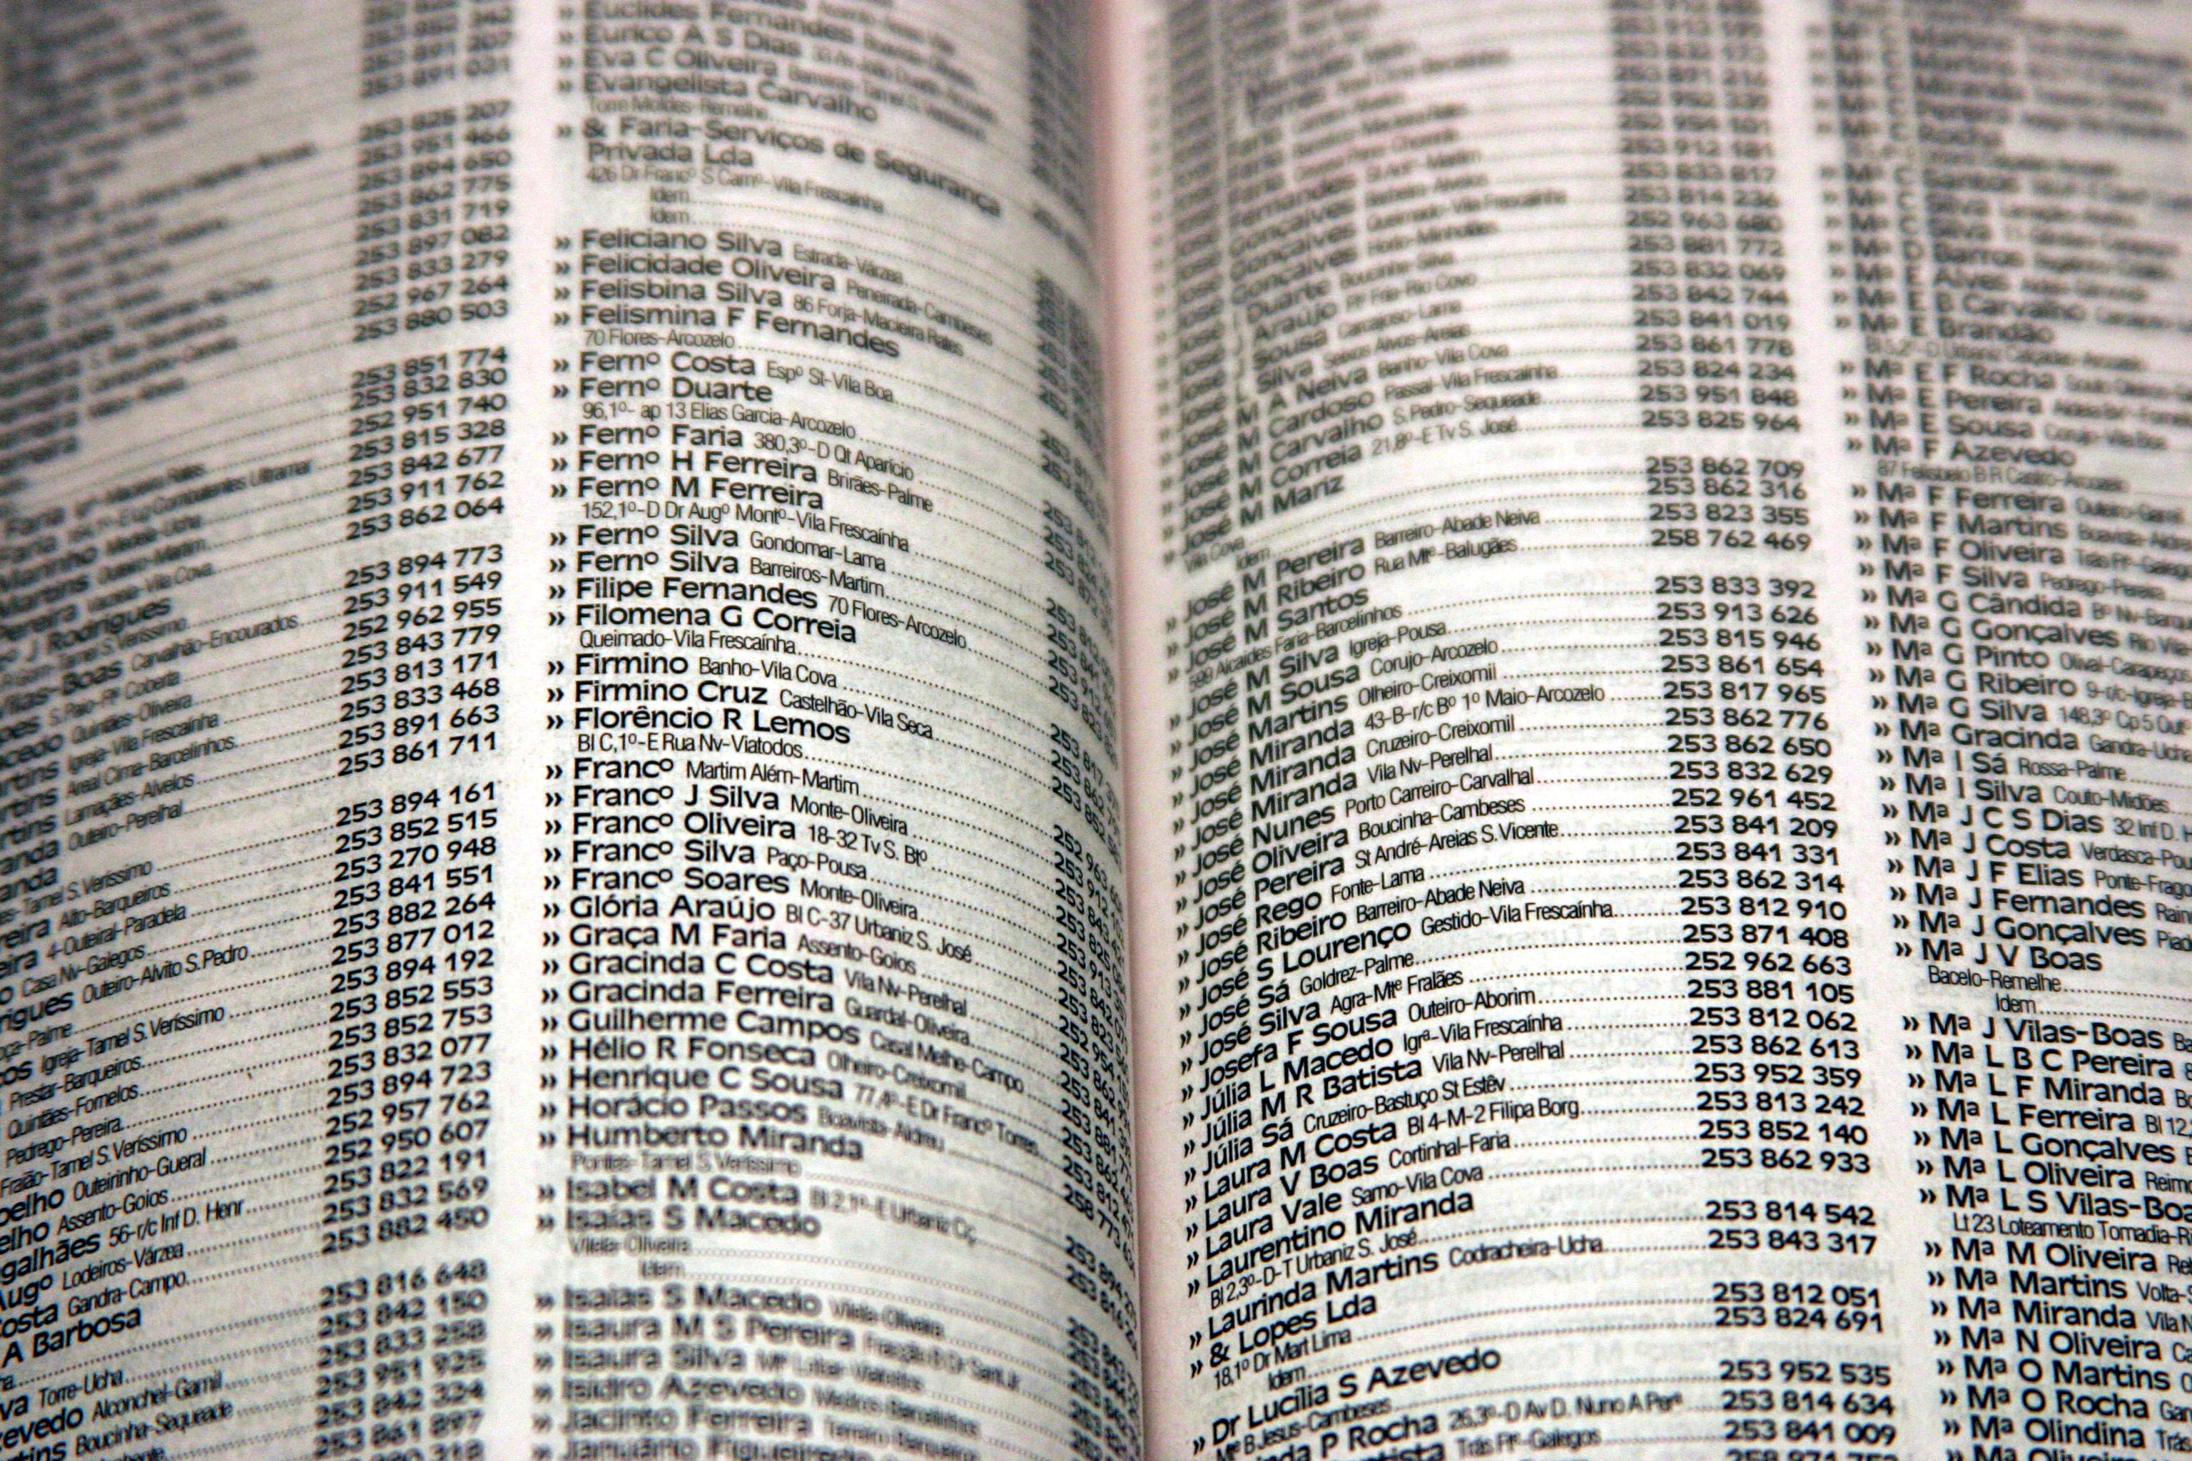
What is Computer Science?
It’s all about solving problems efficiently
What kinds of problems?
Simple example: searching a phonebook (example used by my CS 1 prof on the first day of class)
The problem: Find out whether a certain last name is in a phonebook.
Image source: http://www.plexxi.com/wp-content/uploads/2013/11/phonebook.jpg

Slide 5
An Inefficient Method
Read the phonebook cover to cover, looking for the name you want to find.
That would take…a while.

Slide 6
An Efficient Method: Binary Search
Page # >>
1
2
3
4
5
6
7
8
9
10
11
12
13
14
15
A P P E N Z E L L E R | CA M P B E L L | DONOV A N | F I T Z G ERA L D | G O R D A N | H U D A K | J O N E S | L E C O Z | N O R R I S | P E L L E R I N | Q U I N C E Y | R A B A R O N | S M I T H | W H I T E H O U S E | Y U
Inefficient method: check 13 pages
Efficient method: check 3 pages
Where does computer code come in?

Slide 7
The Logistics of Being a CS Major
Bachelor of Arts (BA) vs. Bachelor of Sciences (BS)
Depends on the college, but, in general…
BA
BS
Classes that aren’t part of the CS core can be anything
Classes that aren’t part of the CS core must be particular physics, chem, math classes
Similar core CS curriculum
Especially good if you want to double major
Some employers require a BS, but the majority are fine with either degree.

Slide 8
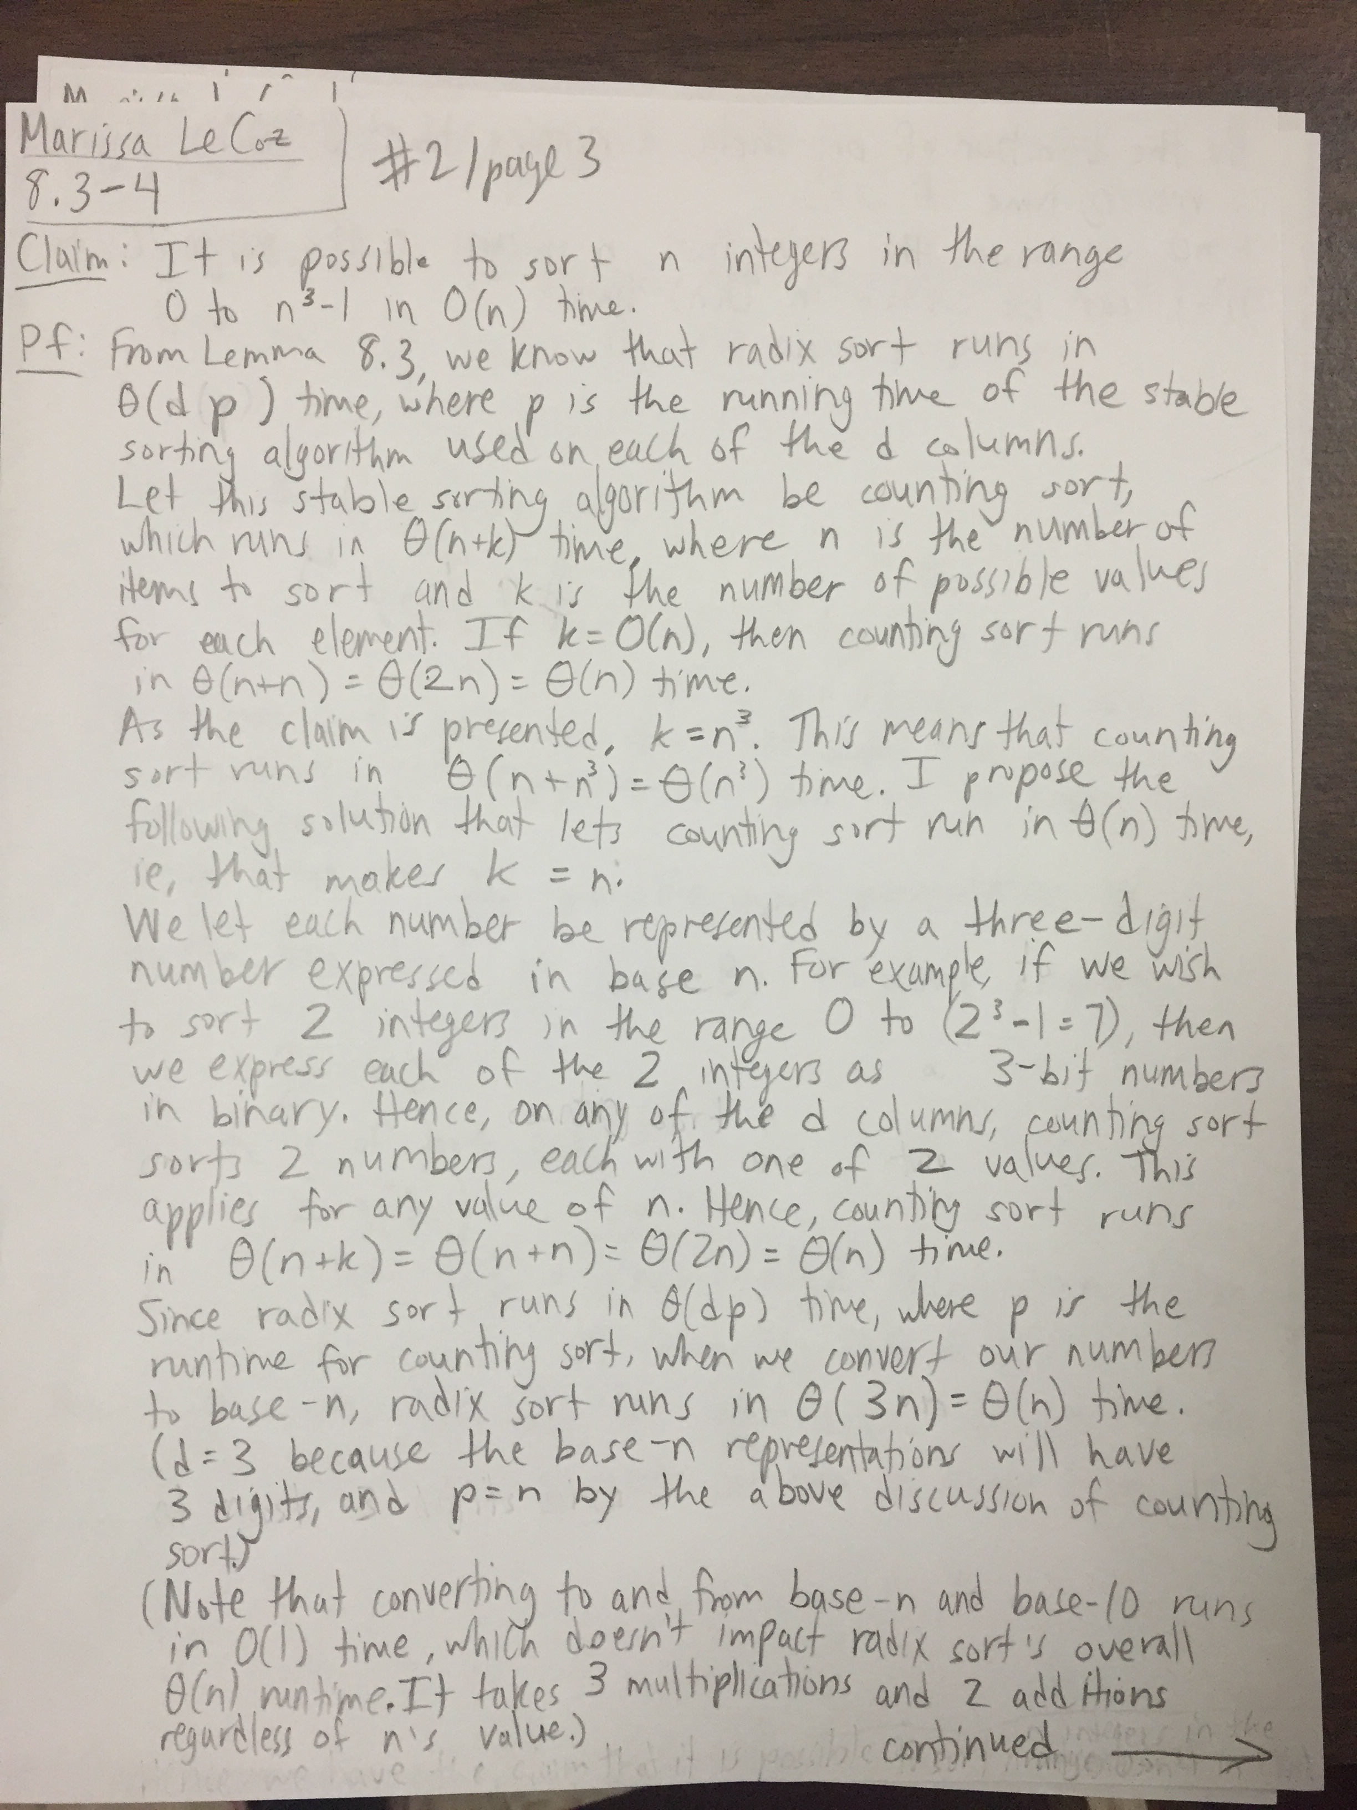
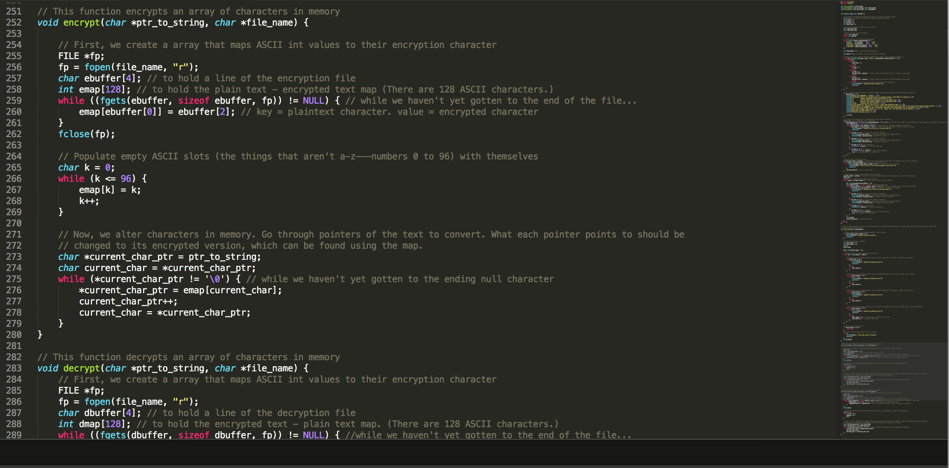
The Logistics of Being a CS Major
CS classes: theoretical vs. applied
Theoretical
Not what you would expect in CS. No computers!
Writing mathematical proofs to show that an algorithm (way of solving a problem) is correct. Mathematically calculating the runtime (efficiency).
Class examples:
Algorithms
Theory of Computation
Computational Complexity
Applied
What you expect with CS: coding in a programming language to make cool things happen.
The bulk of the major.
Class examples:
Software Design and Implementation
Artificial Intelligence
Machine Learning
Smartphone Programming
Computational Linguistics

Slide 9
Top 4 Reasons Why I Love CS
In no particular order
1. Quantitative Yet Creative

Slide 10
Top 4 Reasons Why I Love CS
In no particular order
2. Logic

Slide 11
Top 4 Reasons Why I Love CS
In no particular order
3. Constant Change

Slide 12
Top 4 Reasons Why I Love CS
In no particular order
4. Can work in many fields
Medical Field
Medical Software Companies
Marketing
Marketing Software Companies
Cyber Security
Government
Private Security Groups
Social Media
Facebook, Twitter, etc.
Etc.
Also, both big companies and start-ups need software engineers/developers

Slide 13
Preparing to be a CS major while you’re still in high school
Get a solid foundation in math
Take advantage of EHS’s CS opportunities
Online resources
Code Academy - https://www.codecademy.com/
Kahn Academy - https://www.khanacademy.org/
Tutorial by Dartmouth professors! - https://www.khanacademy.org/computing/computer-science/algorithms

Slide 14
Questions?

